Slide 1
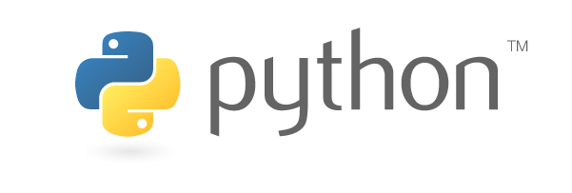
FAIM Python Course for Beginners
27 November 2019 | benjamin.titze@fmi.ch

Slide 2
Python is a…
general-purpose
interpreted
high-level
object-oriented
… programming language.

Slide 3

A brief history of Python
Started out as a “hobby programming project” to bridge the gap between shell scripts and C.
Named after the British comedy group ‘Monty Python’, but the logo is inspired by the snake.
Python 1.0 – 1994
→ 1.x versions are obsolete
Python 2.0 – 2000
→ Latest and final: 2.7 in 2010
Python 3.0 – 2008
→ Currently 3.8 (October 2019)
Python 2 will become obsolete in the long run (won’t be maintained past 2020); Python 3 is the future.
Created by Guido van Rossum at CWI, Amsterdam.
Released in 1991.
Van Rossum was Python’s BDFL (Benevolent Dictator for Life) until July 2018.

Slide 4
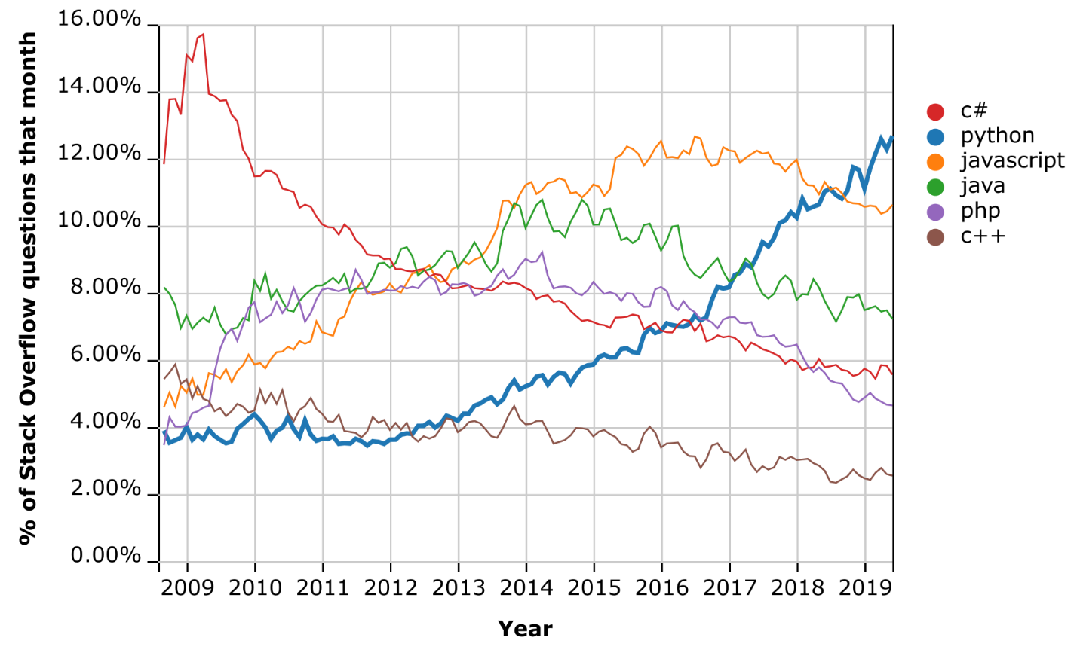
Python has become a mainstream language
Popularity due to ease of use, great community and open-source ecosystem.
Also: it’s free (unlike proprietary software such as MATLAB).
Increasing use by large IT companies: Google, Amazon, Instagram, Dropbox, Spotify, Netflix…
… and it’s the most popular language for machine learning applications.
Among major programming languages, Python has seen the fastest growth over the past decade.

Slide 5
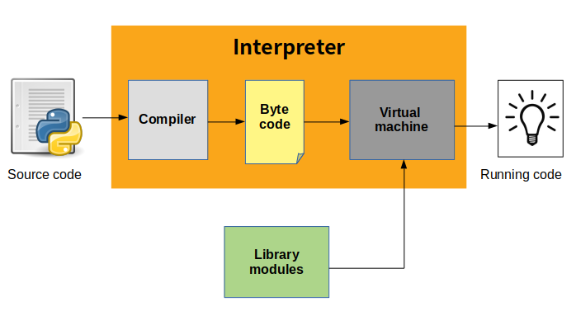
From source code to execution
The source code (*.py files) is first first compiled into byte code (*.pyc files), an intermediate lower-level language for faster execution (but slower than machine code).
Byte-code is run on the Python Virtual Machine.
CPython is Python’s open-source reference implementation.
Source: https://indianpythonista.wordpress.com

Slide 6
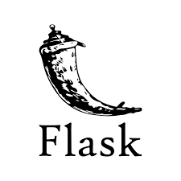

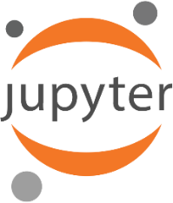
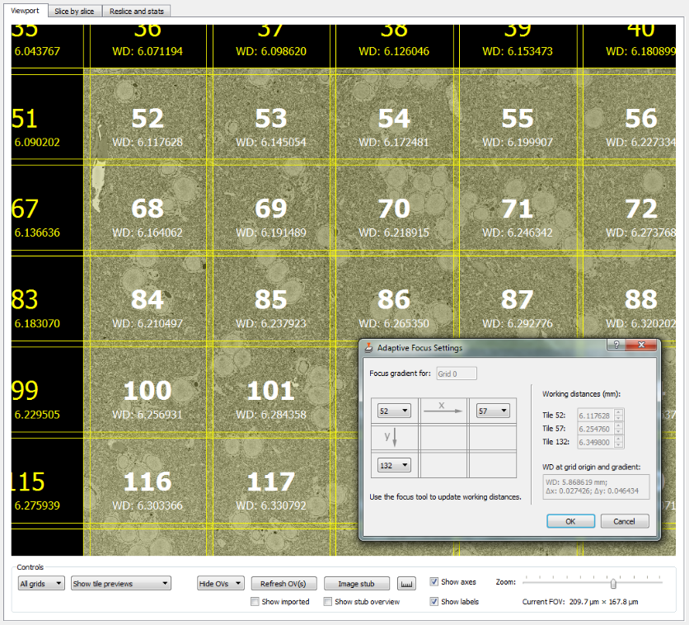
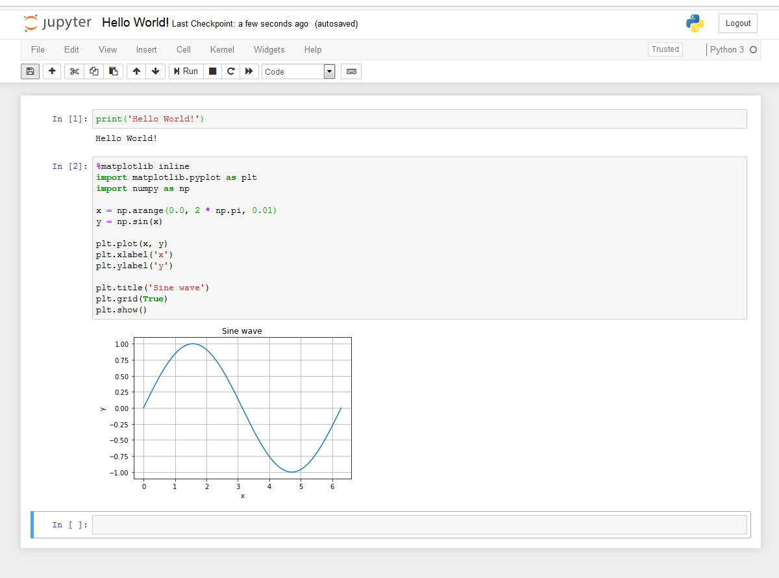
How Python is commonly used
Run from the console/command line/terminal. No graphical user interface, only text.
Web development with frameworks such as Django and Flask
Jupyter Notebook:
a browser-based inter-active programming environment (Julia, Python, R) ideal for
data analysis and visualization.
GUI (Graphical User Interface)-based applications (with PyQt, for example)

Slide 7
Jupyter Notebook
Run from command line / Anaconda Prompt:
jupyter notebook
or launch via Anaconda Navigator.
If it’s not installed yet, install with:
pip install jupyter
or
conda install jupyter
Notebook files: *.ipynb (ending comes from previous name IPython Notebook)
Let’s get started:
Launch Jupyter Notebook in your browser, click on ‘New’ and select ‘Python 3’.

Slide 8
Next steps…
Try to write short (and ideally useful) programs
Use stackoverflow (Google ‘python how to … ‘ – you are almost certain to find advice on stackoverflow). Don’t just copy/paste, but try to understand!
Many courses at Codecademy, DataCamp, www.learnpython.org …
Look for tutorials for numpy, matplotlib, scipy and pandas to get started with data science with Python
Resources for beginners who are already familiar with programming: https://wiki.python.org/moin/BeginnersGuide/Programmers
Resources for beginners with no programming experience: https://wiki.python.org/moin/BeginnersGuide/NonProgrammers

